Slide 2
Do you consider ‘society’ a system?
What do you mean by a ‘system’?
What according to you is an ‘ecosystem’?
Do you think they are ‘interlinked’?
The Anthropocene, as this new era of extensive human impact on the Earth has come to be known (Crutzen 2006), manifests in a closely intertwined set of social and ecological changes – Biggs et al. 2022

Slide 3
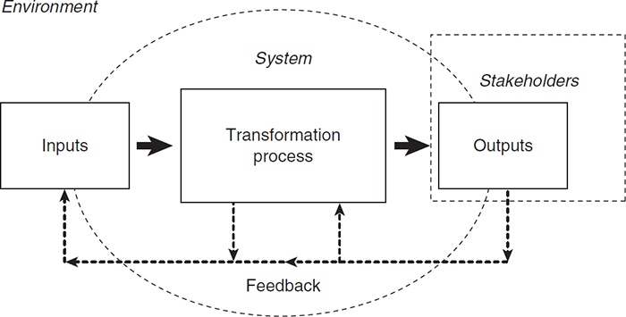
General Systems Theory and Systems Thinking
An association of interrelated parts and interacting elements which function according to a set of rules to form a unified whole
Systems thinking emerged as an alternative to Newtonian “mechanistic, unified and stable” worldview
Natural phenomena can be described beyond fixed laws of Physics and Mathematics
Dynamic interactions among constituents, changes and adaptability characterize the behaviour of the “whole”
Complementary narratives of a single natural phenomena
Cunliffe and Luhman 2012
system - entire ecological system (e.g., a drainage basin)
sub-system - systemic constitutive part within the system (e.g., floodplain)
system component - elements of the system or sub-system having specific properties (e.g., sediment)

Slide 4
Social-ecological system (SES)
A concept for understanding the intertwined nature of human and ecological systems
Developed in the early to mid-1990s through collaboration of scholars working in the interdisciplinary areas of ecological economics and common pool resource systems (Berkes 1989, Ostrom 1990, Costanza 1991)
SES is not merely social plus ecological systems, but cohesive, integrated complex adaptive system characterized by strong connections and feedbacks within and between social and ecological components that determine their overall dynamics and behaviour as a ‘whole’ (Folke et al. 2010, Biggs et al. 2015)
SES addresses pressing issues of current times: climate change, biodiversity loss, livelihood vulnerability, land use change, resource degradation

Slide 5
Emergence of SES
Worldviews | Thinkers | Timeline | Core disciplines | Other disciplines
Empirically based knowledge that is universally applicable could be used to study the nature of phenomena in the world - world as being in equilibrium (stable and steady), orderly, deterministic and predictable | Issac Newton | Late 17th to Early 20th C | Physics and Mathematics | Economics (mechanisation, industrialisation, standardisation of production processes); Sociology (Structuralism); Literary theory (structural semiotics)
1950s : Einstein propounded General Relativity theory which called for a “paradigm shift” | Einstein
General Systems Theory and CAS | Ludwig von Bertalanffy, Gregory Bateson, Von Foerster | 1968 and on | Ecology and Biology | Economics, Sociology, Psychology
Resilience: Panarchy framework of connected adaptive cycles | C.S. Holling | 1973 and on | Ecology | Ecology, Psychology, Geography Economics, Arts and Humanities
Common property arrangements | Elinor Ostrom | 1990 | Ecological Economics | Do
Linked SES | Fikret Berkes and Carl Folke | 1998 and on | Ecology | Do

Slide 6
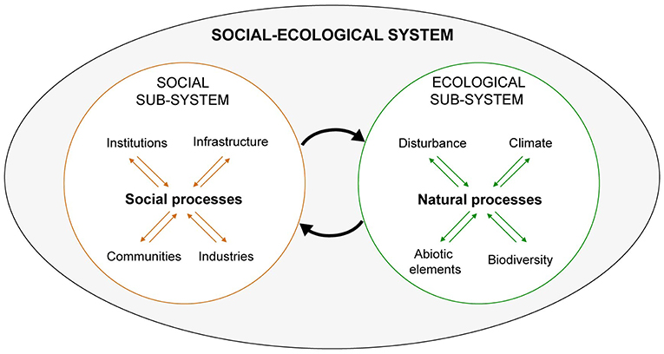
Organizing principles
Relations and interactions
Feedback and adaptive capacity – feedback processes enable to continuously adjust and adapt
Non-linearity – interactions are dynamic and may change in unusual way; small changes can trigger larger implications; e.g. ice sheet collapse, a shift from collaborative institutions for regulating fishing to overharvesting
Unpredictability - complex cause and effect pathways; co-evolutionary nature
Source: Wilcox et al. 2019

Slide 7
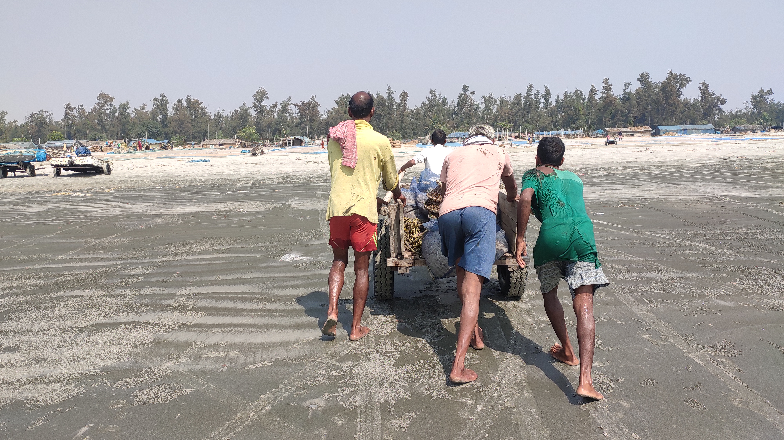
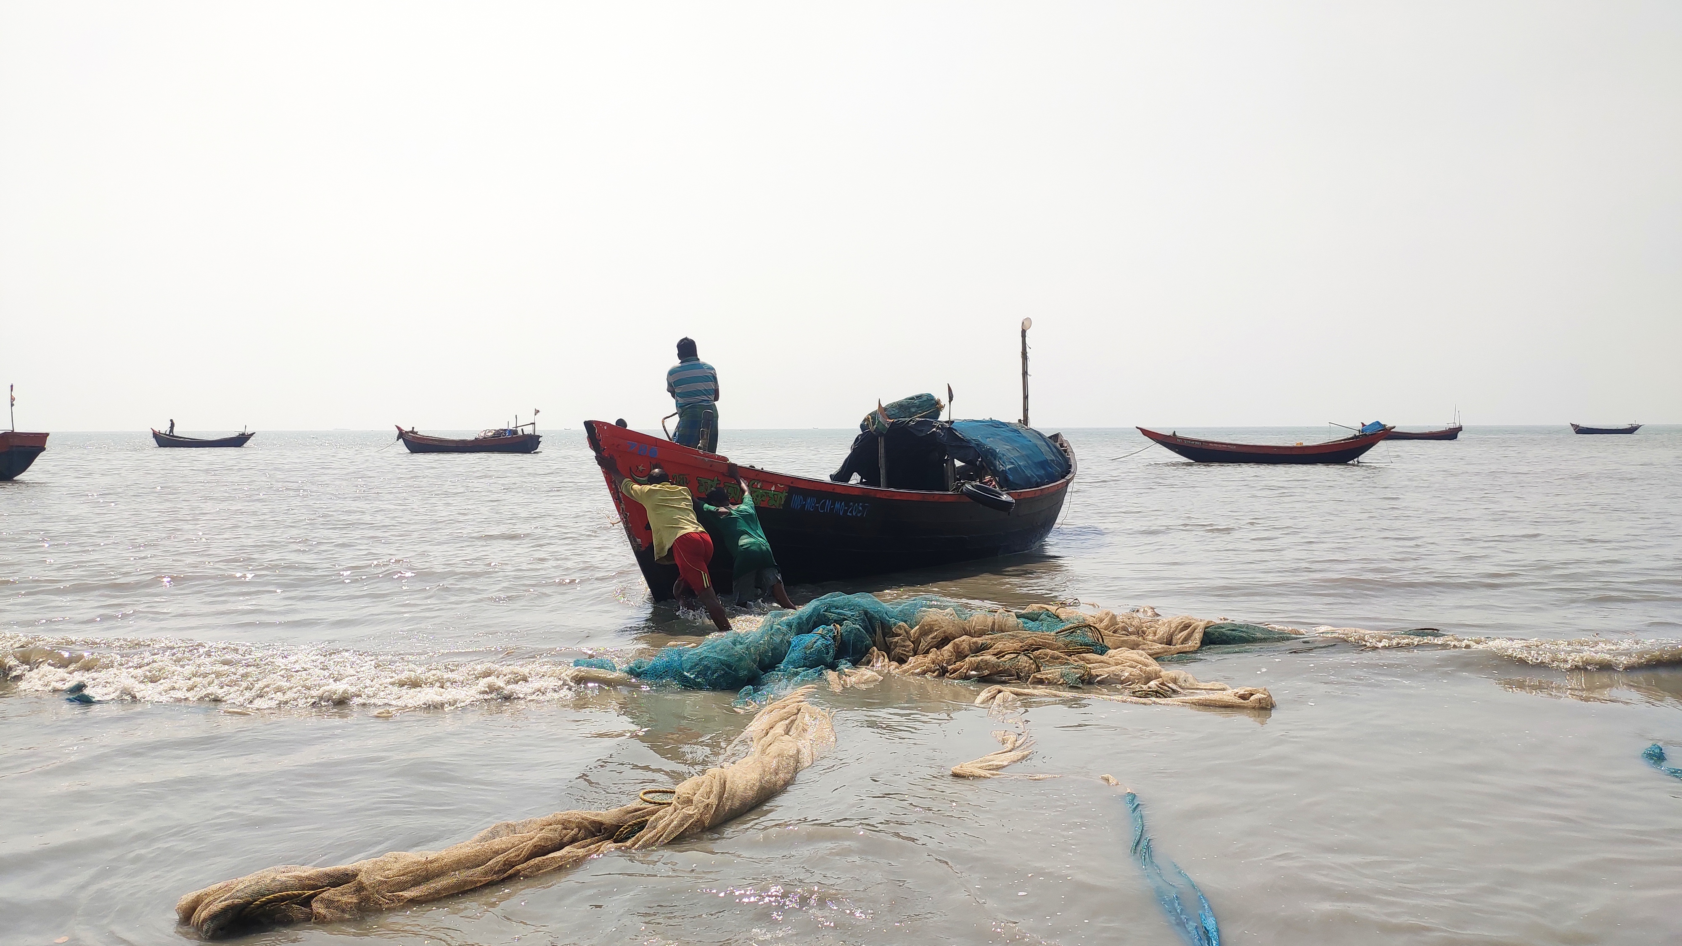
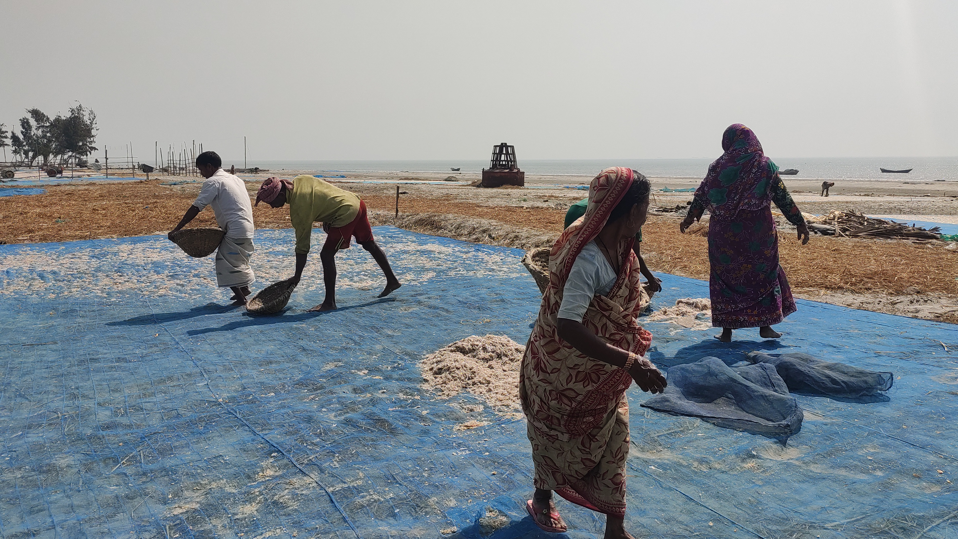
Scenario study 1
2
1
3

Slide 8
Elements of SES
People and technology
Ecosystems
Governance
Institutions
Local knowledge
- Diversity
- Overall ecosystem processes
- Ecosystem health and threats
- Social construct and processes
- Relations among actors
- Values and conflicts
- Assets (tools, land etc.)
- Common pool resources
- Resource accessibility
- Resource governance
- Economy and market
- Norms, values, beliefs (social)
- Government jurisdictions, regulations, legislature, organizational rules (Governance)
- Market
- Cultural traditions
- Ecological and cosmological understanding

Slide 9
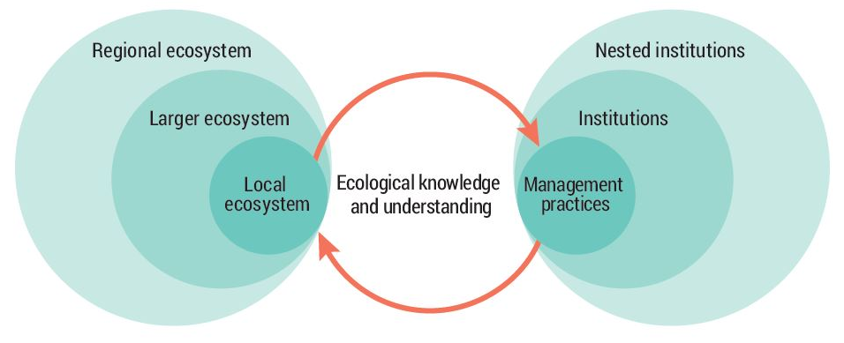
SES framework
SES research is interdisciplinary in nature – particular areas of study include sustainability issues and practices; common pool resource management; resilience assessment; institutional arrangement; adaptive governance
SES embraces transdisciplinarity approach with growing recognition that SES research addresses policies and practices
SES studies are guided by the overarching SES approach and various frameworks linked to particular areas of SES research
Linked SES framework by Folke et al. 2002

Slide 10
Significance of SES research
An interdisciplinary frame offering integrated understandings about linkages, values and interactions in changing environments
Provides an overarching knowledge base for analyzing resource management systems in complex regions (especially the tropics), and designing principles for ecosystem management
Facilitates knowledge co-creation and collaboration among researchers, practitioners and stakeholders to address sustainability issues and policies

Slide 11
Conversations of SES with Political Ecology (PE), Resilience (R) And Environmental Humanities (EH)
PE
Governance and institutions
SES
Complex adaptive systems
Knowledge and values
R
EH

Slide 12
Scenario study 2
Within the peri-urban ecotone of rapidly urbanizing Kolkata city sits the East Kolkata Wetlands (EKW) who accommodates 254 sewage-fed water bodies, interspersed with farmlands.
These wastewater ponds generously serve as the natural sewage treatment plant for the city. Almost 80% of the city’s effluents are treated naturally in the ponds that are used for cultivating a wide variety of fish. The local fishers prepare the wastewater fisheries in natural ways with sunlight, algae, coliforms, and water hyacinths as the ponds receive pre-settled sewage from the Kolkata Metropolitan region.
An exemplary example of sewage-fed aquaculture in the world, EKW is distinguished by the traditional knowledge, skillsets, and wisdom of the local fishers who cultivate and sell fish in the markets of the city.
Spanning across 37 mouzas within the districts of North and South 24 Parganas, the resource recovery system also hosts solid waste dumpsite and agricultural fields that produce paddy and vegetables to meet the city’s daily food demands and ensure food security.
Furthermore, EKW is a home to a diverse species of flora and fauna who help moderate the city's temperature gradient, sequester carbon, and regulate monsoon flooding.
EKW was designated a ‘wetland of international importance’ under the Ramsar Convention in August 2002 for depicting a remarkable socio-ecological metabolism (set of flows of materials and energy that occur between nature and society, between different societies, and within societies) and reciprocal relationship between generated ecosystem services and livelihoods.

Slide 13
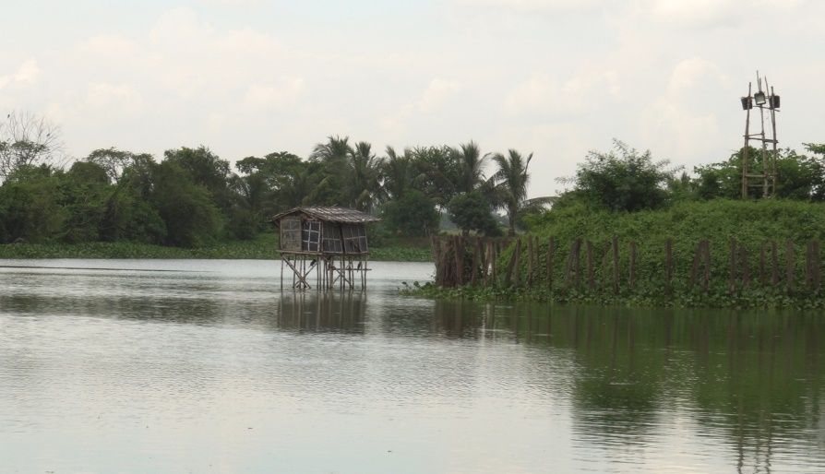

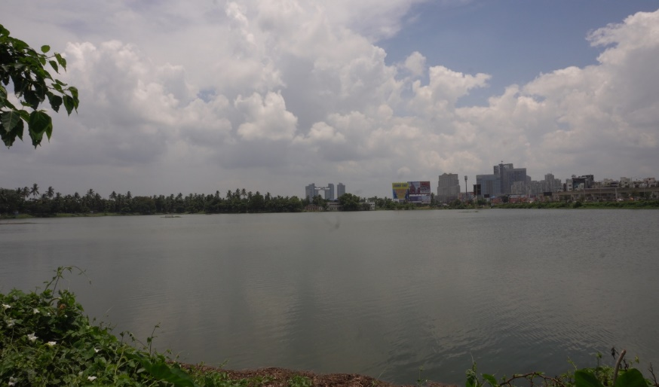
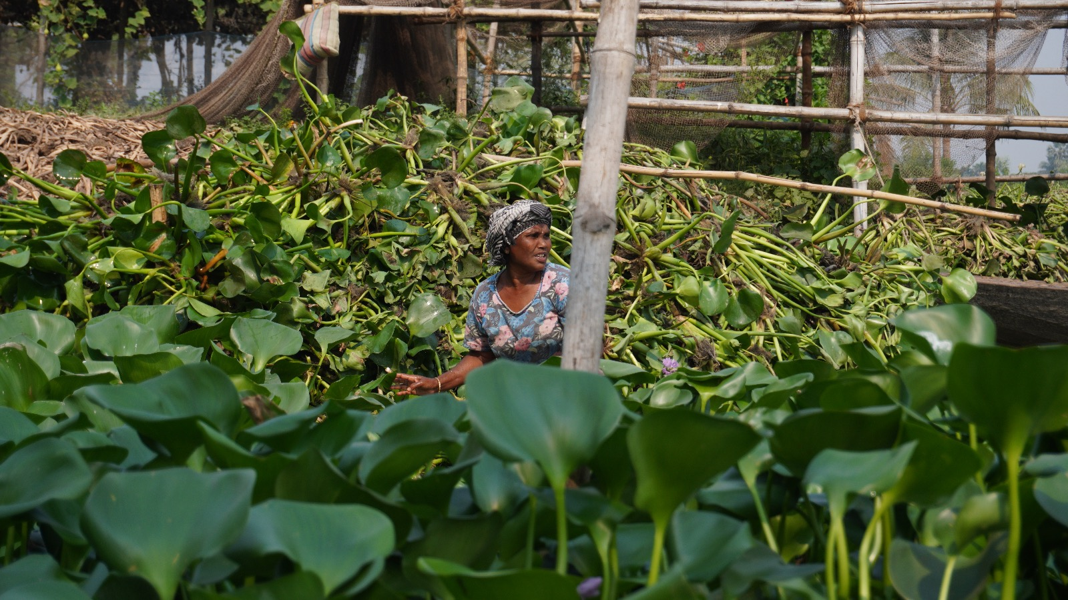
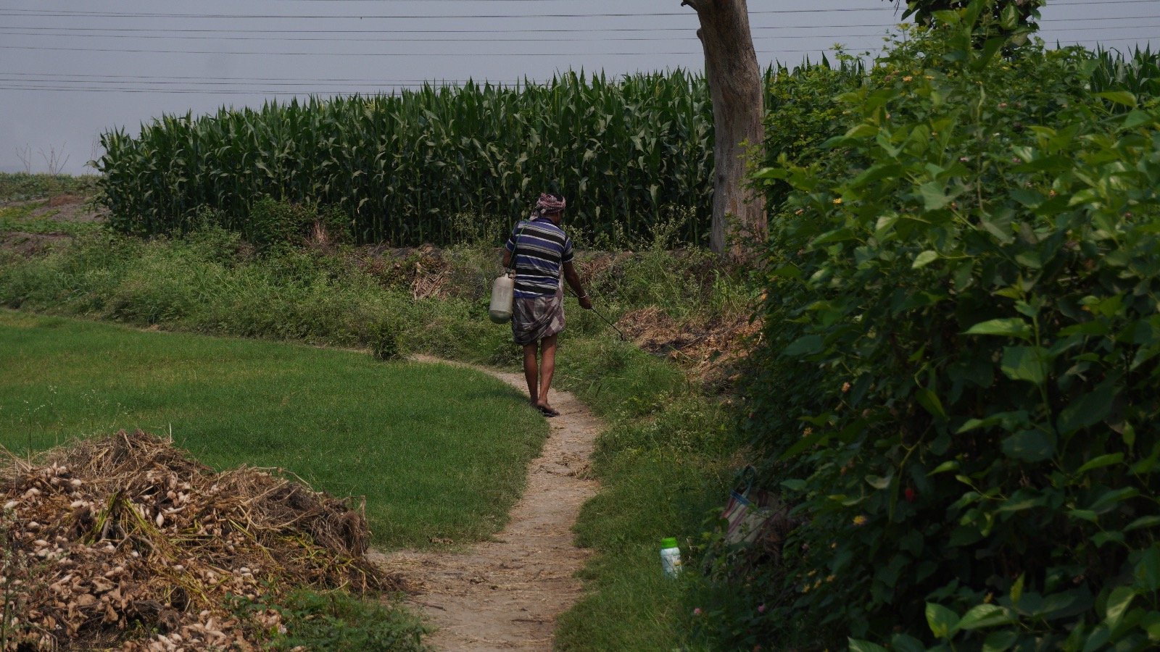
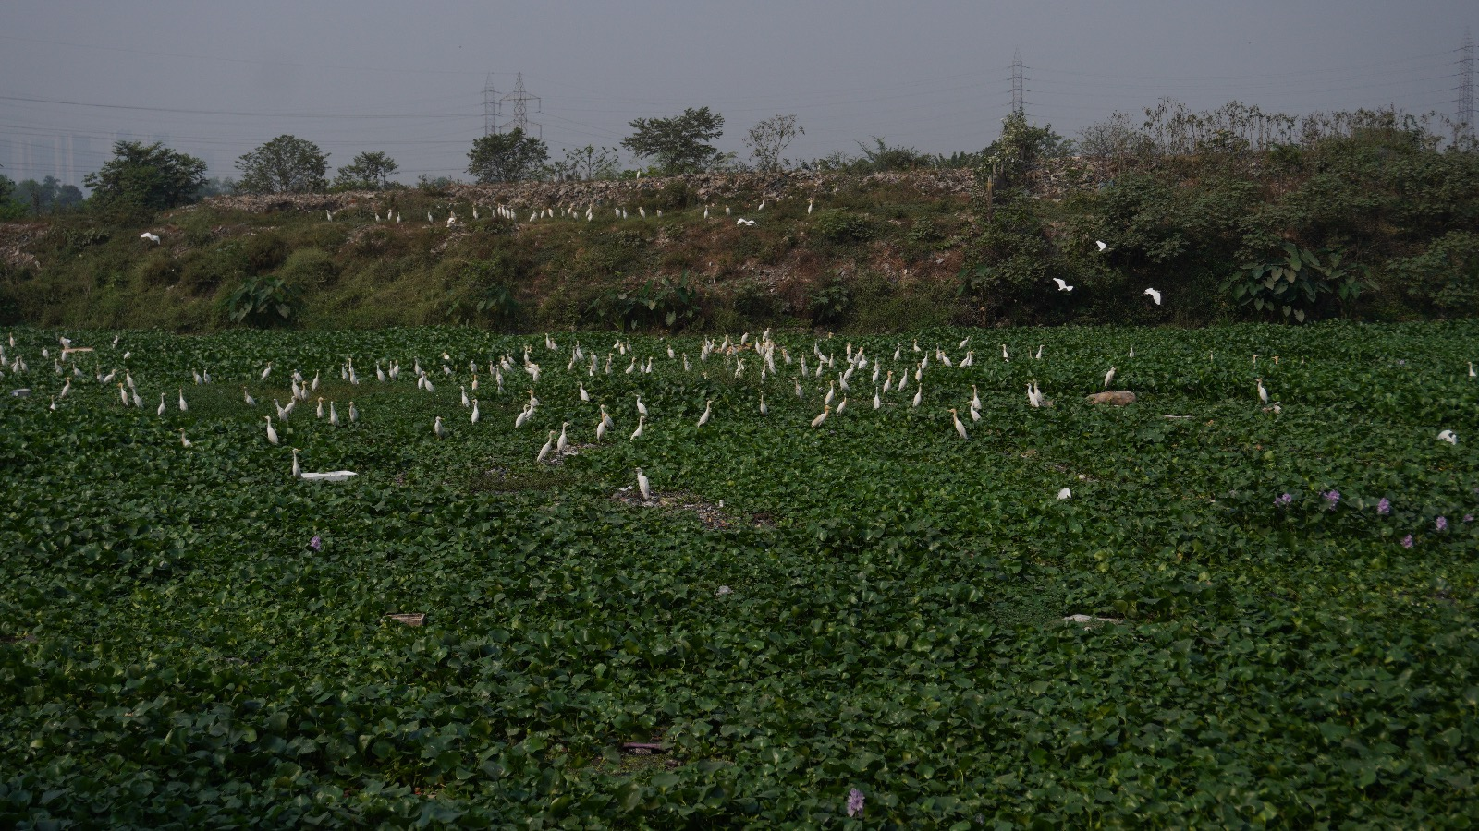

Slide 14
Scenario study 3
Members of the committee appointed by the MoEF and MoTA to look into the implementation of FRA, 2006, visited the Simlipal TR in July 2010. They visited the villages of Bakua and Kabatghai that are both slated for relocation from the reserve and also, the resettlement site of Ambadiha, where families of another village relocated from the core, Jenabil, are settled.
In a report released in September, the committee has noted the following regarding the implementation of FRA, 2006 in the aforementioned villages of Simlipal:
i) The process of filing individual forest rights claims at Bakua began only in June 2009 and the filing of community forest rights (CFR) claims (also in Kabatghai village) began only in July 2010. The CFR forms were filed by officials and were violative of FRA and improper in many cases.
ii) It was found in both the cases that villagers were under the predominant impression that they have to move out of the reserve, and they cannot have rights in the core area. The fact that the FRA allows them to stay inside with various rights was not simply explained to them.
iii) Villagers of Bakua categorically stated they did not want to move out and that even though two palli sabha meetings have been convened to discuss this, they had refused consent to relocation.
iv) 61 Kolha tribe households were relocated from Jenabil to Ambadiha earlier in 2010, with 40 taking land/homestead and 21 took cash as compensation.

